Slide 1

Customer Recommendation Engine
December 9, 2022
NBC Tower, Downtown Chicago
Prepared By
River North Analytics

Slide 2






Meet the Team
Takuma Koide
Sam Ding
Kshitij Mittal
Jieyu Zhang
Xiao Pang

Slide 3
Team Approach
Takuma Koide
Sam Ding
Marketing Creative Designer
Product Strategist
Content Creation and Delivery
Economic Analysis, Business Strategy
Analyzing how different products should be positioned for a particular consumer segment
Conducting real-world economic assessments, and gauge project profitability
Kshitij Mittal
Marketing Analytics Manager
Communication, Marketing Strategy
Responsible for end-to-end project execution, handling client conversations
Xiao Pang
Jieyu Zhang
SEO Analyst
Data Engineer
SEO, Product Analytics, A/B Testing
Content Creation and Delivery
Analyzing product affinities at a consumer level, proposing content personalization strategies
Providing an adequate data engineering pipeline for high quality analytics

Slide 4
Agenda
Problem Statement
Data Overview
Opportunities
Segmentation Deep Dive
Recommendation Engine
Economic Analysis
Timeline and Future Scope

Slide 5
Problem Statement

Slide 6
Problem Statement
Situation
We aim to investigate if more personalized solutions can be developed to increase customer activity
Solution
Outcome
Expected 20% plus incremental sales from the most engaged segment of customers (~15%)
We propose a new customer segmentation based on RFM Framework
Recommendations will be personalized based on users’ prior purchases and relationship with the website
Our client is an online bookstore platform
Currently they recommend only the most popular items for all customers

Slide 7
Data Overview

Slide 8



Sales Overview
33,713 Customers
627,955 books sold
30 genres
$8.49M Sales

Slide 9
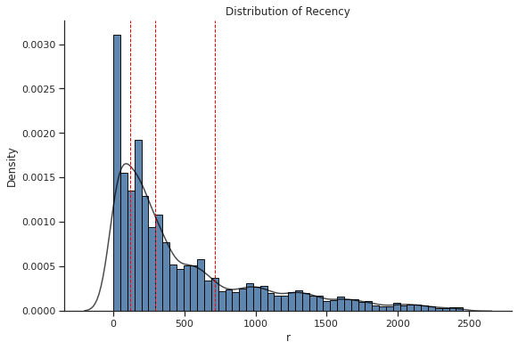
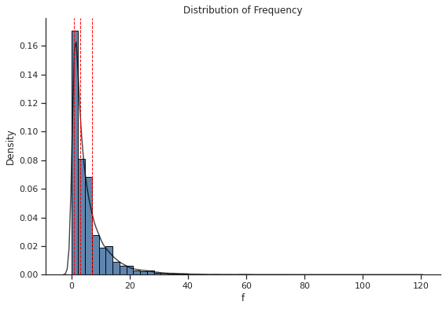
Recency & Frequency
~ 50% customers have a recency lower than 300 days and a frequency lower than 3 items in this time frame

Slide 10
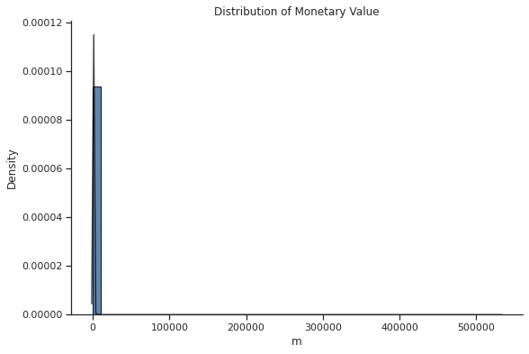
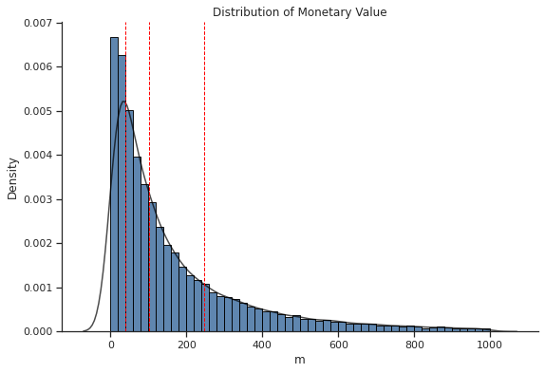
Monetary Value
The original data had many outliers. These were eliminated during the analysis process
We are identifying that close to 75% customers have a monetary value < 250$

Slide 11
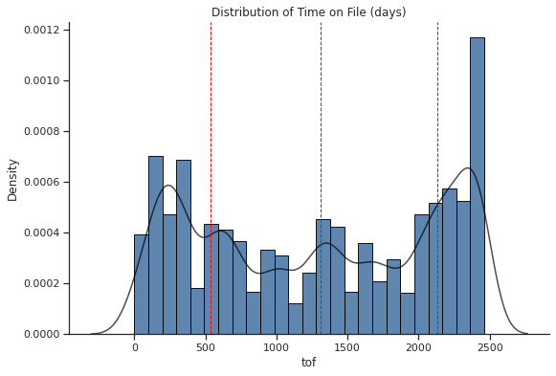
Time on File (Days)
There is a healthy balance between new and old customers, with close to 50% ranging between 1.5 to 6 years

Slide 12
Popular Categories of Books
Account for more than 57% of total transactions

Slide 13
Book Categories with highest dollar sales
Account for close to 57%
of Total Revenue

Slide 14
Opportunities

Slide 15


Opportunities
Product Recommendation Engine
Increased the overall revenue by 35%
Activated more than one-third of total unit sales
Movie Recommendation Engine
Saves the company $1 billion per year
Close to 80% of subscriber video choices come from these recommendations
Proposed: Book Recommendation Engine
Can assist in activating 20% additional sales from the highest usage segment
Notes:
For the 29% increase in sales from $9.9 billion to $12.83 billion during the same year, the recommendations cause more than a third of its product sales.

Slide 16
Segmentation Deep Dive

Slide 17
Four segments were developed using RFM
Segment 1: 15-16% ”Can’t Lose them”
Segment 3: 24% ”Potential and Promising”
Segment 2: 32% ”Loyal Champions”
Segment 4: 28% ”Requires Attention”

Slide 18




All segments show distinct behaviors
Segment 1
Segment 2
Segment 3
Segment 4
Highest importance segment
Spends the most time with the platform
Engages in high value transactions
Active platform users
Motivated to spend time on the platform
Buy items whenever the need arises
Use platform on specific need-to-need cases
Do not have a high affinity for the online bookstore, but use it as need arises
Least frequent users for the platform
Do not spend any time or money on the platform

Slide 19
Segment 1 provides more areas of opportunities
Segment 1
Segment 2
Segment 3
Segment 4
Highest importance segment
Spends the most time with the platform
Engages in high value transactions
Active platform users
Motivated to spend time on the platform
Buy items whenever the need arises
Use platform on specific need-to-need cases
Do not have a high affinity for the online bookstore, but use it as need arises
Least frequent users for the platform
Do not spend any time or money on the platform

Slide 20
All segments vary widely

Slide 21
Segment 1 has the highest R,F,M values

Slide 22
Recommendation Engine

Slide 23
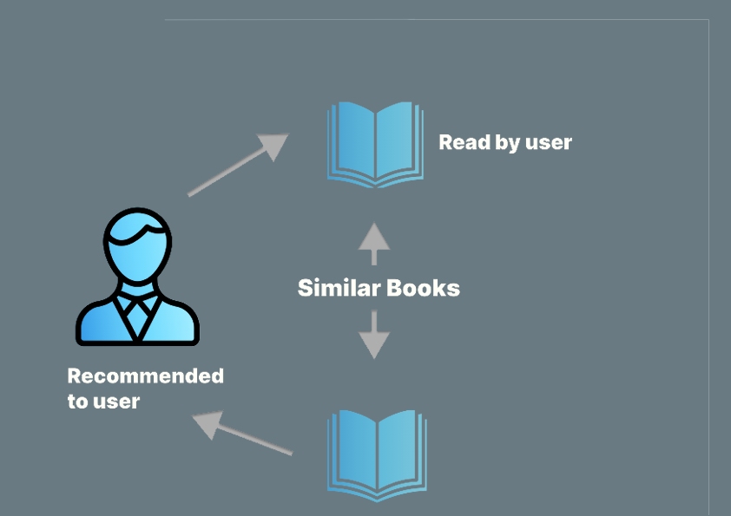
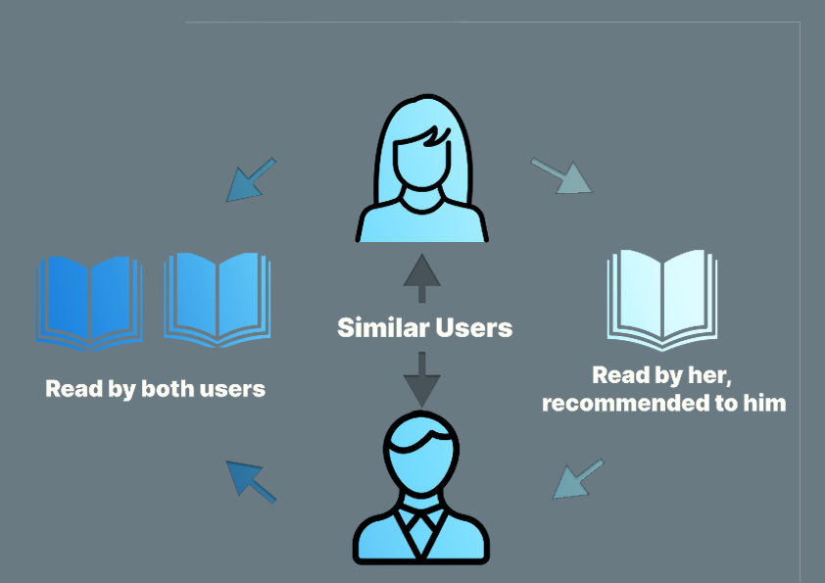
Recommendation Engine Models
Content-based filtering
Collaborative filtering
Notes:
For the 29% increase in sales from $9.9 billion to $12.83 billion during the same year, the recommendations cause more than a third of its product sales.

Slide 24
Economic Impact

Slide 25
Focusing on the top 15% segment results in:
+20%
Monetary Increase for the Top 15% Customers
$500
Avg. Monetary Value per Top 15% Customer
5100
Number of Customers
in the Top 15% Segment
Direct Economic Benefit: +$520K
6% Increase in Sales

Slide 26



Focusing on the top 15% segment results in:
Monetary Increase
20% monetary increase for the top segment
Direct economic benefit: $520K+
Increasing Customer Loyalty
Recency increase by 20%
Frequency increase by 20%
Potential economic benefit: $1M+
Higher Per Capita Profit
Cut maintenance and unpredictable spending by 30%
Profit margin per capita increase by 30%
Potential economic benefit: $1.5M+
Total long-term economic benefit: $2M+

Slide 27
Timeline and Next Steps

Slide 28
Timeline and Next Steps
Week 1
Week 2
Clean Data and EDA investigations
Develop RFM Customer Segmentation Model
Week 4
• Conduct a soft launch
Week 3
Build Recommendation Engine with two filtering algorithms
Week 5 – 6
Week 7-8
• Make Economic Analysis
• Collaborate with IT team to set up the back-end processes
• Deploy the new features on the website
• Fine tune the engine based on the cusrtomer response
We are here right now

Slide 29



Future Scope
Model Improvement
Continue to improve the recommendation engine based on the Top segment customer’s behavior
Improve the User Interface based on customer feedback
Strategy for the 85%
Propose the cost-effective recommendation model such as simply recommending books from their favorite category instead of all books
Develop marketing strategies to non-frequent users to encourage them to experience the new recommendation engine
Operation Improvement
Explore more algorithms to improve the efficiency of Supply Chain and Inventory, meeting increasing customer demand
Develop big data strategies for implementing the segmentation algorithm in real time for the entire customer base.

Slide 30
Thank You!

Slide 31
Questions?

